Slide 1
Service Orders
How-to

Slide 2
Service Opportunity – Pre-sales Elements
Drive
Discovery – solution building
Opportunity Qualification
Communication
Definition – tech meetings
Approval Process – get the signature
Coordinate
Closing Actions
Define
Maintain Salesforce Opportunity
List of Actors

Slide 3
Operating with Awareness
Healthy Opportunity
If you know something,
put it in the opp.
Document pertinent points and decisions in the opportunity.
Each field in the opportunity is there for a reason.
Service sales can execute with precision.
Notes:
While this is written with the opportunity owner in mind, specific tasks can be delegated to the ISR.

Slide 4
Services Order Cheat Sheet
Create Salesforce Opportunity
Engage with Services Organization
Scope
Summarize service opportunity
Indicate service Line of Business or select “Needs Line of Business”
Select Services Analyst or Needs Services Analyst
Define service need
Strategize
Coordinate
Define need
Match need to services
Generate Rough Order of Magnitude
Tech calls with customer
Finalize
Use ROM to negotiate final scope and rates
Services Analyst to generate SOW
Process Service Order
Attach fully executed SOW to Salesforce opportunity
Procure discount approval, if necessary
Ensure SOW aligns with opportunity
Roles
Rates
Deliverables
“Send to Services Order Review”, button
Attach fully executed SOW
Services rep contacts sales team
Set Status to “Pending Scoping”
Set Status to “SOW Creation”
Set Status to “Signed, Undelivered”
Send

Slide 5
Who can Create an Opportunity?
Outside Sales Rep
Services Sales Rep
Inside Sales Rep
Area Vice-president
Sr. Vice-president
Anyone that can log into Salesforce

Slide 6
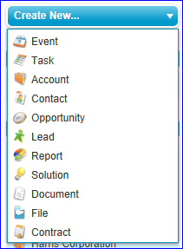
The First Step
Salesforce Homepage

Slide 7
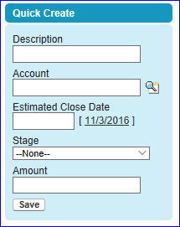
The First Step
Salesforce Opportunities Tab

Slide 8
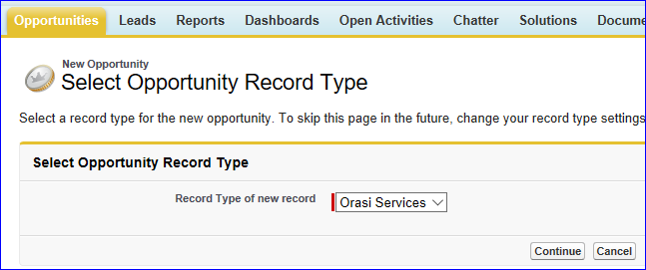

Opportunity Type
Orasi Services

Slide 9
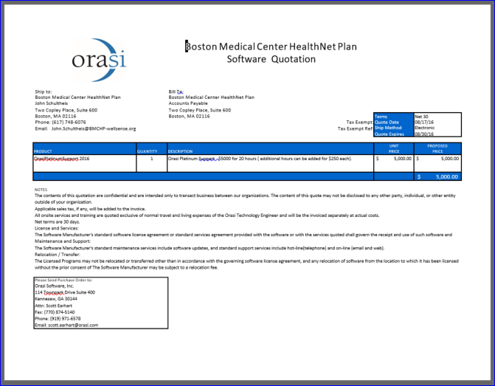
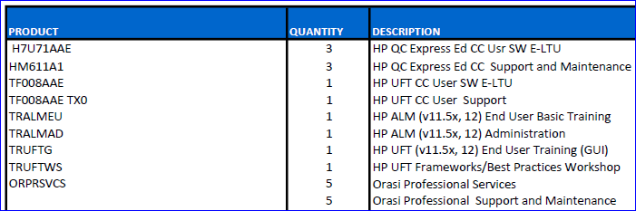
Training Sales
Our preference is that Training be sold with a quote.

Slide 10
Types of Services
Assessments
Mentoring
Installations
Upgrades
Automation
Functional Testing
Performance Engineering
Test Data Management
Data Masking
Mobile Testing

Slide 11
Services Resources
Roadmap Assessment: Improving Software Quality
Global Software Testing Services
Orasi University
Orasi Services Catalogs
http://www.orasi.com/wp-content/uploads/2016/09/orasis_roadmap_assessment_improving_software_quality.pdf
http://www.orasi.com/wp-content/uploads/2016/08/Global_Software_Testing_Services.pdf
https://university.orasi.com/lms/
http://www.orasi.com/resources/services-catalogs/

Slide 12
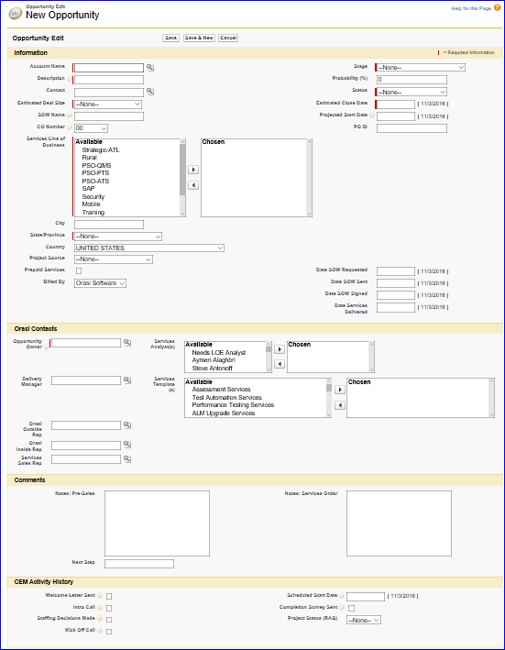
New Opportunity Sections
Information
Orasi Contacts
Comments
CEM Activity

Slide 13
Project Work – Existing FY18
Select “Project Work-Existing”, if one of these clients.
Customer | Rep |  | Customer | Rep
Allegis Group, Inc. | Valentine |  | IBM Cloud Video (Formerly Clearleap) | Biddy
AutoTrader | Biddy |  | Kiewit | Thompson
AutoZone | Giles |  | Mobius Partners - All Other | Humphrey
BB&T | Biddy |  | Mobius Partners - Exxon | Wood
Capital Group | Carroll |  | OG&E | Huffman
CDW Corporation | Cartina |  | Smith & Nephew | Giles
Commerce Bank | Cartina |  | Southwest Airlines Co. | Huffman
Cox Companies (Except Cox Ent & AutoTrader belong to Biddy) | Lewis |  | TD Ameritrade/Scottrade Inc | Thompson/Valentine
Cox Enterprises | Biddy |  | Toyota - All | Carroll
Darden Restaurants | Burns |  | Walt Disney - All | Lewis
GreenSky, LLC | Biddy

Slide 14
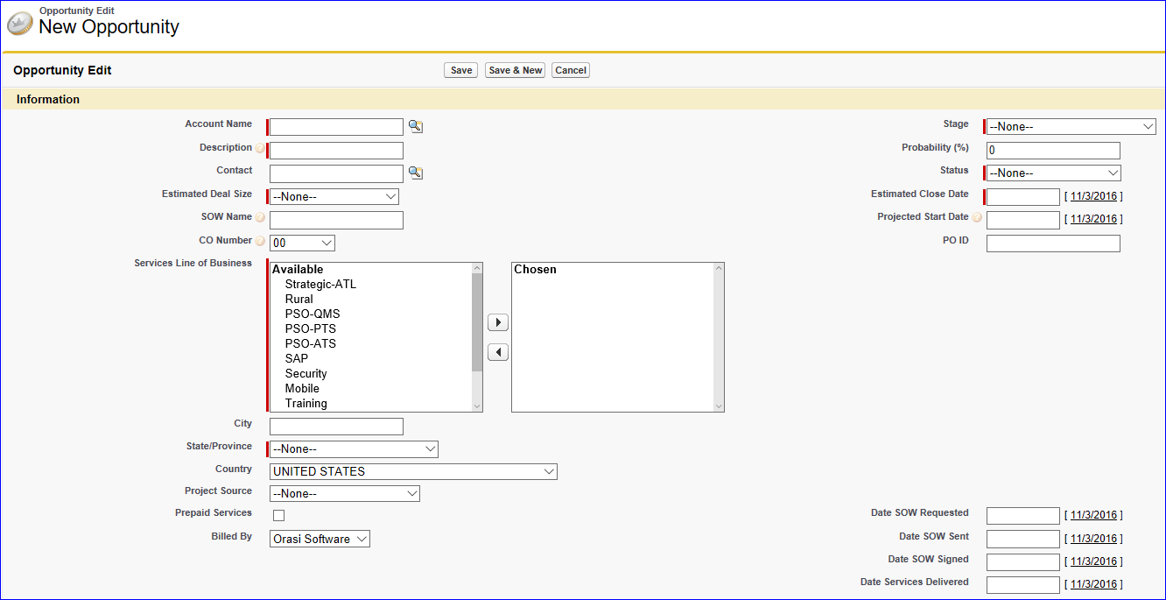
Information Section
Required fields are noted with a red score.

Slide 15
Information Section
Account Name
Description – general opportunity parameters
For ex.: SAP functional testing services
Estimated Deal Size
Services Line of Business (next slide)
State
Stage
Status
Estimated Close Date
Complete These Fields

Slide 16
Line of Business Heads & Guidelines
Strategic Atlanta
Bill Hayden
Ann Pierce
Accounts regionally central to Atlanta
Advanced Testing Services
David Guimbellot
Advanced Performance Monitoring
Performance Testing Services
Mobile
Brian Crout
Quality Management Services
SAP
Mobile
ALM / UFT
Onsite & Mobile Test Automation
Test Management
Rural
Mobile
Virginia Vestal
Training
Data Analytics & Visualization
David Hand
Don McElwee
Hosting
OARS
Business Intelligence
Test Data Management
Continuous Delivery
Functional Testing
Performance Testing
Performance Assessments
Performance Mentoring
Security
Dennis Hurst
Saltworks
Z-Other
N/A
Sub-contract work

Slide 17
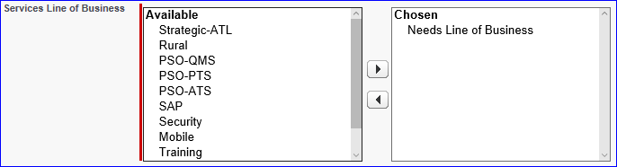
Need Help Determining the Line of Business?
Select “Needs Line of Business” if you aren’t sure.
This triggers an alert for someone from services delivery to contact the sales team.
Our goal is to respond to you before the close of business that day!

Slide 18
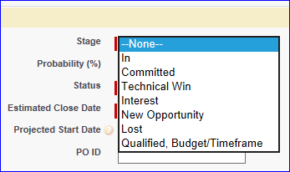
Stage Progression
SELECT
New Opportunity
Interest
Qualified, Budget/Timeframe
Technical Win
Committed
In

Slide 19
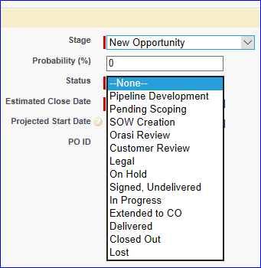
Status Progression
Pipeline Development
Pending Scoping
Legal
On Hold
Signed, Undelivered
In Progress
Extended to CO
Delivered
Closed Out
Customer Review
Orasi Review
SOW Creation
SELECT

Slide 20
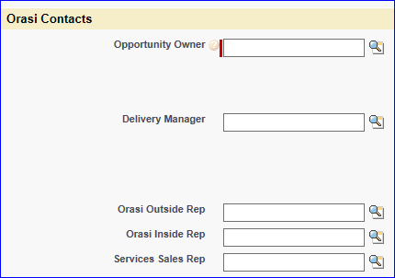
Orasi Contacts Section
Enter if known.

Slide 21
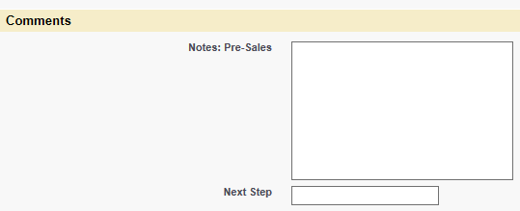
Comments Section
Note any general information pertaining to qualification.
Bob Jones runs a functional testing team that needs support during heavy release cycles.
Enter if known.

Slide 22
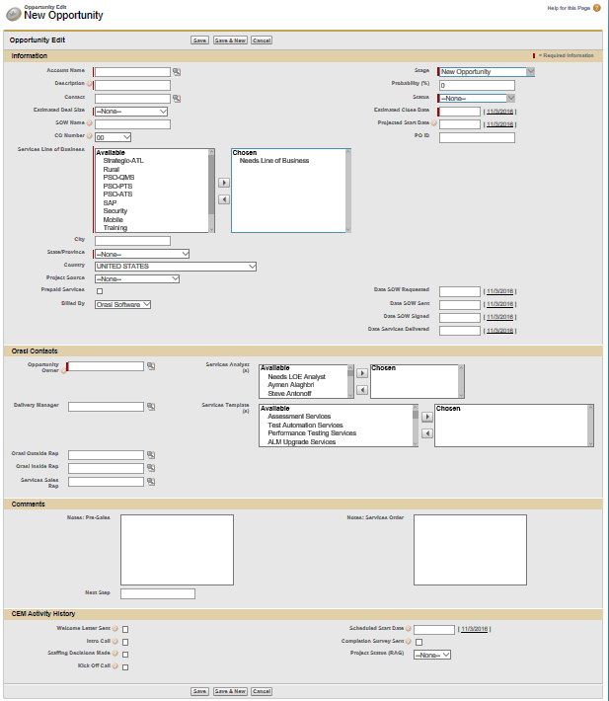
Save

Slide 23
What happens to my opportunity now?
Need Line of Business?
A services representative will contact the Opportunity Owner to flesh out which Lines of Business can help
Line of Business Known
A Services Analyst will be assigned.
The Services Analyst will contact the Opportunity Owner for discovery conversation.
Opportunity Owner to update Pre-Sales notes accordingly and assign a Line of Business.
Services Analyst will update the opportunity with a new note containing pertinent information in the Notes section.

Slide 24
Stage Progression
New Opportunity
Interest
Qualified, Budget/Timeframe
Technical Win
Committed
In

Slide 25
Stage Descriptors
New Opportunity
Customer has a need for services that Orasi can provide.
Interest
Stakeholders have been identified.
Qualified, Budget/Timeframe
Opportunity owner has worked with customer to identify a business challenge or service need that Orasi can help them overcome.
A solid understanding of the customer’s approval process allows timeframe expectations to be understood.
Technical Win
Stakeholders have given fiduciary approval verbally.
Customer’s technical parties have been won over.
Committed
All required paperwork has been submitted to the customer and approvals are in process.
In
Fully executed documents have been exchanged.
Opportunity Owner has had meaningful qualification discussions with customer.
Exploratory discussions with customer.
A level of opportunity boundary definition is in place to facilitate detailed budget discussions.
A Rough Order of Magnitude is appropriate.
A Proof of Concept may be considered.
An SOW may be requested.

Slide 26
Status Progression
Pipeline Development
Pending Scoping
Legal
On Hold
Signed, Undelivered
In Progress
Extended to CO
Delivered
Closed Out
Customer Review
Orasi Review
SOW Creation

Slide 27
Status Descriptors
Pipeline Development
Initial qualification – assorted & misc. sales magic
Pending Scoping
Budget identified
Client-side technical contact identified
Management stakeholder identified
Buyer identified
Executive sponsor identified
What - Identify general business need
Why - Identify driving impetus
Objective - Identify success criteria
Questionnaire delivered
When - Identify timeframe

Slide 28
Status Descriptors
Technical success criteria has been determined.
Orasi Review
SOW format and content is sent for approval.
Questionnaire had been completed.
Budget and terms have been determined.
SOW Creation
Customer Review
Timeframe expectations have been set.
SOW has been delivered to customer for review or signature.
Upon approval, Opportunity Owner delivers to Customer.
Services Analyst develops or reviews SOW and sets Status to Orasi Review.
Automatic trigger
SOW attached to opportunity.

Slide 29
Status Descriptors
Legal
Customer’s SOW format is under Orasi legal review.
Substantial changes to the Orasi approved SOW template.
MSA approval needed.
On Hold
Signed, Undelivered
Fully executed SOW in-hand.
Signature Exception has been granted by SVP.
In Progress
Extended to CO
Delivered
Invoiced
Closed Out
Paid
Designated as such by sales team.
Stagnant for 4 months.
A Change Order has been signed, extending this engagement.
Sent to Services Order
Kick-off meeting scheduled
45 days past Estimated Close Date

Slide 30
Development Status
New Opportunity
Identify business need
Interest
Map business need to Orasi service offerings.
Develop relationship with stakeholders
Identify success criteria
Look for Champion

Slide 31
Execution Status
Qualified Budget \ Timeline
Business need identified
Technical Win
General budget accepted
Success criteria identified
Economic buyer identified
Champion identified
Success criteria accepted
Client technical team prepared
Pre-requisites and dependencies have been accepted
Stakeholder convinced

Slide 32
Roles & Responsibilities
Communication
Outside Rep
Develop ROM
Outside Rep
Services Analyst
Develop SOW
Services Analyst
Send to Services Order Review
Outside Rep
Services Analyst
Services Sales Rep
Services Sales Rep
Services Sales Rep
Negotiate Terms
Outside Rep
Services Sales Rep
Services Analyst
Services Analyst

Slide 33
Supplementary Roles
Inside Sales Rep
Acts as surrogate for the outside sales rep.
Services Analyst
Guides detailed technical discussion
Develops solution
Presents solution
Fields technical questions
Enters technical details, resources and rates into the opportunity
Develops ROM
Develops SOW

Slide 34
Discount Approvals
Up to 15%
Salesperson
16 – 25%
1 Sr. Vice-president
More than 25%
1 Sr. Vice-president: Sales
1 Sr. Vice-president: Delivery
*Automated process in Salesforce

Slide 35
MSA Process
New MSA’s must be reviewed by Orasi legal team at NewVendors@Orasi.com
MSA’s go here in ezone https://ezone.orasi.com/Contracts/Shared%20Documents/Customer%20Contracts
On the customer account homepage in Salesforce.

Slide 36
Information Required for an SOW
Account Name
Account Billing Address
Contact (manager or above)
Name
Title
Phone
Email
Services Address
Services Description
Business objective – Customer has identified this challenge and contracted Orasi to …
Scope – hours, milestones
Deliverables -
Orasi Resources
Rates
Terms
Travel Policy

Slide 37
Closing Status
Committed
In
Executed paperwork is attached to the opportunity.
SOW language finalized
MSA approved by Orasi legal department
Terms agreed upon
SOW in the client’s hand’s

Slide 38
Purchase Orders
For product sales
For Training Units
Acceptable in lieu of an SOW

Slide 39
Training Units
Used for all Orasi training SKU’s (Training Unit)
HPE Training is a separate HPE SKU
Delivered on-site or virtual
Cost
On-Site = $4K per day up to 12 students
Need approval to go over 12 students due to licensing restrictions in lab
Virtual = $500 per day per student
1 Training Unit costs $1,000
Can sell ½ Training Units
On-Site Example
UFT GUI – 3 Days @ $4K per day = 12 Training Unit
Virtual Example
ALM Administration – 1 day @ $500 per day x 1 student = ½ Training Unit
For course offerings and to sign-up visit https://university.orasi.com

Slide 40
Signature Exception Policy
Up to $50k
Area Vice-president
Up to $250k
1 Sr. Vice-president
More than $250k
1 Sr. Vice-president: Sales
1 Sr. Vice-president: Delivery
*Manual process

Slide 41
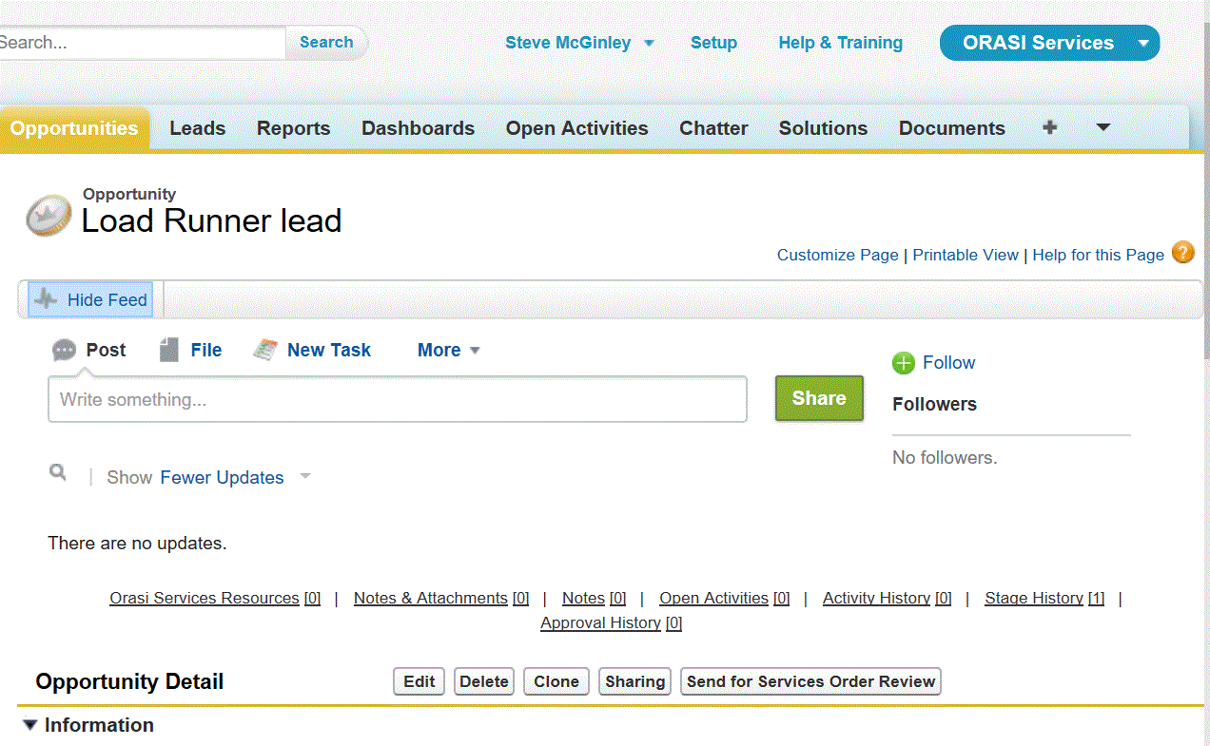
Services Order Review

Slide 42
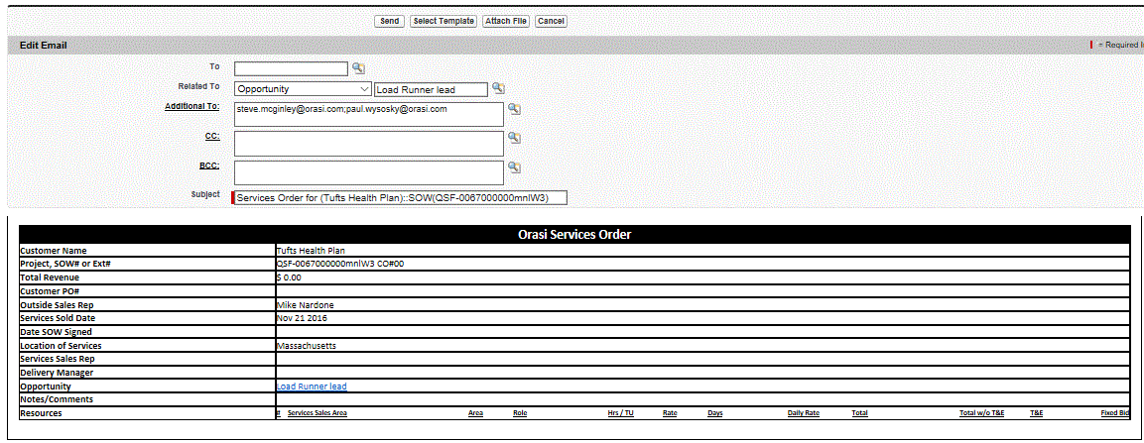
Services Order Review

Slide 43
Services Order Review
Required Fields
Customer
Project
Total Revenue
Customer PO#, if no SOW
Outside Sales Rep
Services Sold Date
Date SOW Signed
Location of Services
Services Sales Rep, if appropriate

Slide 44
Services Order Review
Ensure terms are aligned in the SOW and opportunity.
Press “Send”
Customer Experience team reviews
Attach executed SOW

Slide 45
Services Order Review
Return to Submitter
Services Order
Missing details
Numbers don’t match
Project setup in Time Consultant

Slide 46
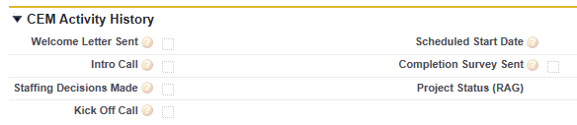
Signed, Undelivered
Delivery Manager is assigned and takes the baton.
Remain in touch with your opportunity here!

Slide 47
Happy Path
Create opportunity and enter initial description.
Services Analyst contacts Sales team to refine the deal parameters and provide next steps.
Sales team schedules tech call with client and Services Analyst.
Sales team sets the opportunity to Pending Scoping.
Services Analyst enters technical details into Salesforce.
Rough Order of Magnitude is developed.
Sales team negotiates final terms.
Services Analyst updates the opportunity with finalized terms.
Outside Sales Rep sets the opportunity to SOW Creation.
Services Analyst develops SOW.
Sales delivers SOW to customer.
Executed SOW is attached to the opportunity.
Opportunity is sent to Services Order Review.

Slide 48
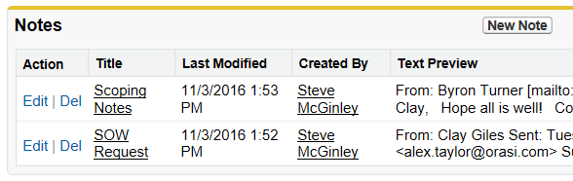
Slide Illustrating Notes Section

Slide 49
Change Orders
Require a new opportunity
When signed, original opportunity is set to “Extended to CO” status
Require SVP exception beyond -50 hours

Slide 50
Closed
Services Delivered
Invoice Paid

Slide 51
Caveats
JIRA Bridge – goes to QMS unless custom work, then goes to David Brown.
Security line of business = Saltworks
Services Sub-contracted to Orasi – how-to?
Platinum Support - $250/hour
$0 changes = Amendment because a Change Order requires a new Salesforce Opp.
List rates are determined by each line of business.

Slide 52
Using Salesforce as the Common Platform
Chatter
Real-time text
Collaborative workspace
Salesforce for Outlook Plug-in
Add emails to Salesforce from Outlook!
Reports
Opportunity List
What am I waiting for?
Needs Line of Business
Needs Scoping
Needs SOW
Customer Review
Salesforce Tasks
Assign a task to someone!
Keep your opportunity up to date.
Stay abreast of updates.

Slide 53
Oversight & Support
New Opportunity alert – to CEM team
Pending Scoping alert – to CEM team
Needs Services Analyst alert – to CEM team
Line of Business Services Analyst
Technical definition
SOW
Needs SOW alert – to CEM team
Discount Approval report to Approvers
Services Order Review – CEM team
Services Order – Operations team
Opportunities past Expected Close Date report

Slide 54
Services Opportunity Escalation
SvcsOppEscalation@Orasi.com
Jim Arnold
Jim Azar
Caleb Billingsley
Mark Lewis
Karl Rubin
Steve McGinley

Slide 55
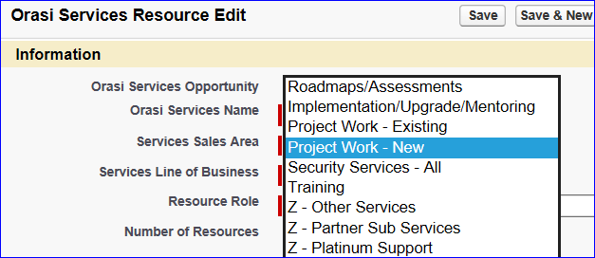
Services Sales Area

Slide 56
New Hire Workflow

Slide 57
Thank you!

